Slide 1
4-1 Encounter Design
5CM503 Virtual Environment Development
Dr Patrick Merritt

Slide 2
Contents
Encounters

Slide 3
Encounter
!

Slide 4
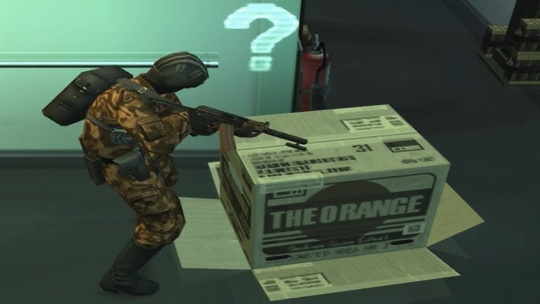
What is an encounter?

Slide 5
What is an encounter?
An encounter is a sequence of systemic challenges that support a variety of player tactics.
sequence: there can be multiple beats / waves / challenges in a row
systemic: using a repeated design language of game elements
variety: ideally, not just one specific solution or best strategy
tactics: improvised short-term play style / behaviour
https://book.leveldesignbook.com/process/combat/encounter
https://www.youtube.com/watch?app=desktop&v=BPmd9pZKTxE

Slide 6

What counts as an encounter?
In general, when we refer to an encounter, we often are referring to a PvE battle.
Commonly refers to fighting the bad guys.
Does not have to be guns or swords!
(DRATINI! I CHOOSE YOU!)
Should be adversarial.
Not just against an environment
(Puzzles anyone?).

Slide 7
The design is influenced by the story…
Last week we created the concept for the level, our list of challenges and events.
These all had a basic narrative set for them, we can now expand each of these to be more specific and setup the challenges within the encounter.
Design the specifics of the beginning middle and end of the fight.

Slide 8
and the gameplay!
Before we begin designing encounters, we need to refer back to our games design document…
What kind of game are we developing here?
What types of gameplay will our player have?
Ranged, melee, stealth etc?
Are all of these approaches accommodated?
Nobody likes getting halfway into a game to find that their build or playstyle is no longer valid!
Does not mean you have to make it equally difficult for all scenarios/

Slide 9
and the gameplay…
What skills does the player have?
Are they guaranteed to have that skill or is it optional?
No point in designing an encounter that requires a double jump to finish if the player possibly cannot double jump!
Placing the player in impossible challenge is usually a bad move unless that’s something you are designing for.
Even if you are, at least telegraph to the player that the challenge is impossible!
Do you provide the player opportunities to use skills creatively?
Does the player have a silver bullet strategy?
Is that a good thing?

Slide 10
Begin the combat…
Setup your enemies in relation to the challenge and story…
Where are the bad guys?
Are they patrolling around, unaware of the danger?
Are they rushing to attack the player after an alarm is raised?
Have they taken up positions waiting for the player to attack?
Is the player familiar with the enemies and composition?
How does the player enter the encounter?

Slide 11
Encounter entry points…
Also referred to as foot holds. These are methods of triggering the encounter.
Allows us some control of how we get the player to engage with the enemy.
Changing the foothold can change the feel of the encounter.

Slide 12
Player Ambush!
The player gets the drop on the enemies.
Enemies exist in the game map at the start.
Although adding more later is possible via multiple methods.
Enemies are unaware and behaving as such.
Patrolling, slacking off, talking giving information.
Player choses if, how and when to engage.
Maximum freedom, maximum opportunity!
Lowest control of the narrative.
Because you don’t control how the player engages, you don’t control the pacing as well.

Slide 13
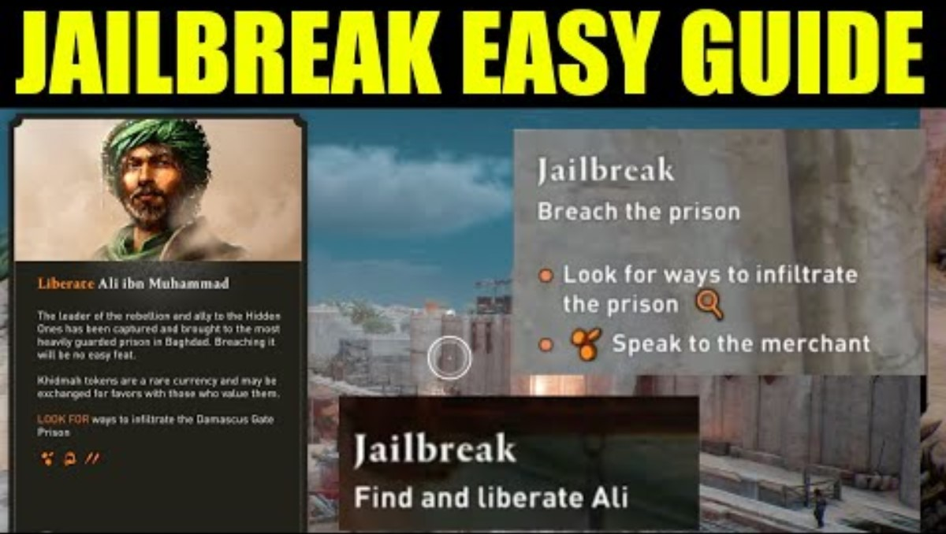

Slide 14
Enemy ambush!
The player enters a seemingly quiet area and triggers and ambush!
A clear trap!
Disguising these is more difficult the more you use them!
Eventually an empty room becomes a signal that there is an ambush coming.
Same as dropping large amounts of powerups / equipment with no need for them…
The trap only works once!
Dying and respawning means the player must voluntarily activate the trap again.
Lowest player control
Deal with the immediate problem, with little control of how you engage with it.
Great narrative control!
DON’T THINK SHOOT…

Slide 15
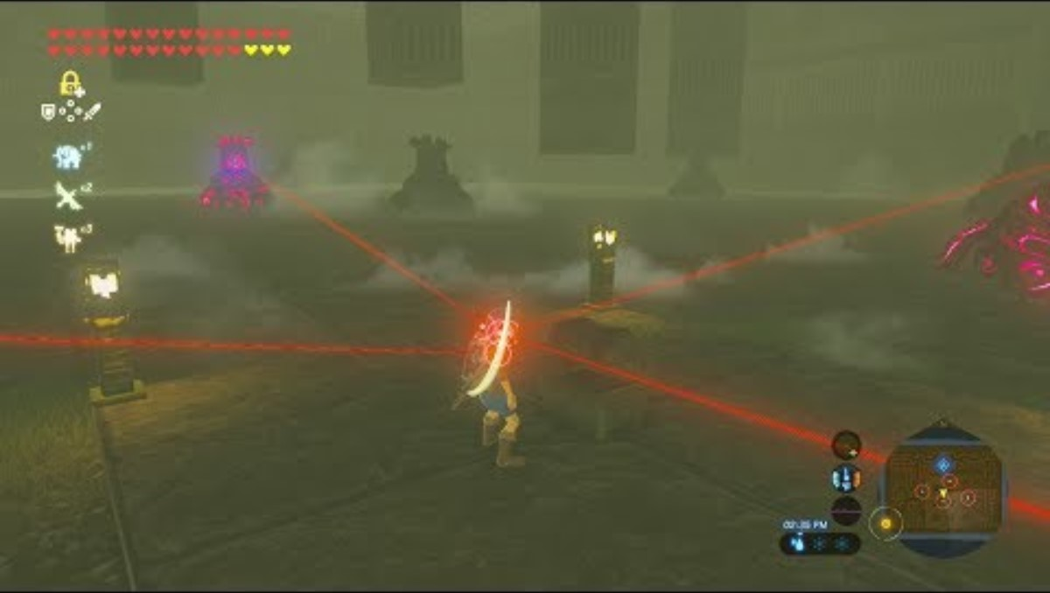

Slide 16
The One-way lock / caged beast
The player is shown an area with enemies that are unaware of their presence.
Only one way into the fight with minimal options for engagement.
Dropping down a ledge or slamming a door behind them.
Fair engagement.
The player can make a plan prior to committing.
Great control.
This is the problem, you have to deal with it.
Great for boss fights

Slide 17
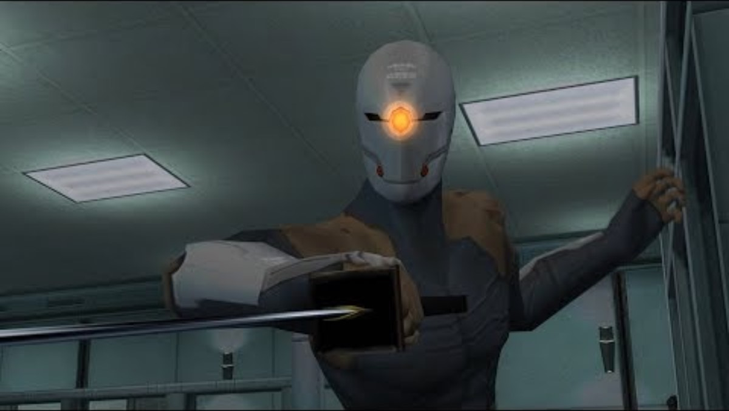

Slide 18
Area Design
The design of the area the encounter occurs in can greatly change the way the encounter is perceived by the player.
How enemies appear and where can result in drastically different experiences.

Slide 19
“Mob” variety
The number of different enemies used in a game is important to balance.
Enemies will have different engagement patterns, behaviours, strengths and weaknesses.
It is important the player is taught how to deal with each enemy type in a reasonable way, usually independently.
The number of different enemies is just as important as the quantity. More mobs = more complexity.
About 3 is the norm, with more or less added to increase complexity
Only counts the number currently engaged with the player, at the same time.

Slide 20
Flat
Uniform movement all around, no advantage or disadvantage to either side.
Ground clutter provides cover, defensive opportunities as well as controlling the pace.
More = slower pace.
Simple, easy to put together.
Kinda boring / repetitive if overused.
Common for boss fights.

Slide 21
Varying heights
By varying heights we open up tactical options for both enemies and players.
Create preferred routes of travel by restricting movement or forcing the usage of movement mechanics.
Generally more interesting and unique.
Makes AI a little harder to build.

Slide 22
Advantage
Places the enemy or player in an advantageous position and allows them to exploit the advantage.
Presents a unique challenge.
Runs the risk of creating an unfair situation.

Slide 23
Bottlenecks
Forces the play and enemy to engage through one or more chokepoints in the map.
Caused either by level geometry, or necessitating an actor to be in a specific position.
Creates a gameplay focus and challenge, but can lead to exploitation of AI if done poorly

Slide 24
Ledges
Falling down is easy, getting back up.
One way movement locks.
Players and AI should seek these advantageous positions, pressure from the opponent should force them to move out.

Slide 25
Spawning
How we introduce new enemies into a level affects…
Challenge
Pace
Difficulty
Narrative

Slide 26
Chaos
Everything attacks you all at once.
Very difficult for the player to deal with.
Usually results in defensive play from the player.
Can create overwhelming force if the player is ill equipped to deal with the problem.

Slide 27
The one on one.
Commonly used for boss / mini boss fights.
Also used to introduce new powerful enemy types.
Set pieces usually have narrative significance.
“trash” can be added to force movement and increase pressure.

Slide 28
Triggered phases
Player starts off fighting a wave of enemies.
More enemies are introduced when the player does a thing.
Not passive, must be actively triggered by the player. A player-controlled experience.
Can lead to cheese if triggers are too obvious.

Slide 29
Events
Enemies are introduced as certain conditions are met.
Commonly time passing or enemy deaths.
Can be used to balance gameplay difficulty
Only spawning more enemies once the previous ones are defeated.
Spawning enemy's on a timer promotes aggressive play.

Slide 30
Delays
Level design setup means enemies cannot engage the player all at the same time.
Allows the player time to “deal” with one enemy before the rest show up exhibiting tactical control.

Slide 31
Progression
Spawning gradually harder enemies allows you to build to a climatic point in the encounter.
Kill the minions and thier boss will show up.

